Slide 1
UK Top 50 Music Analysis using Machine Learning
Name: Kalpna Singh
Course:
Project: ML Internship

Slide 2
Objective
Study artist dominance
Analyse UK Top 50 playlist
Predict hit songs using ML

Slide 3
Dataset
1000+ songs dataset.
Features: Artist, Popularity, Position, Duration, Explicit

Slide 4
Data Preprocessing
Removed null values.
Removed duplicates.
Created ‘Hit’ column (Top 10 songs)

Slide 5
Exploratory Data Analysis
Popularity distribution analysed
Position distribution analysed
Trends observed

Slide 6
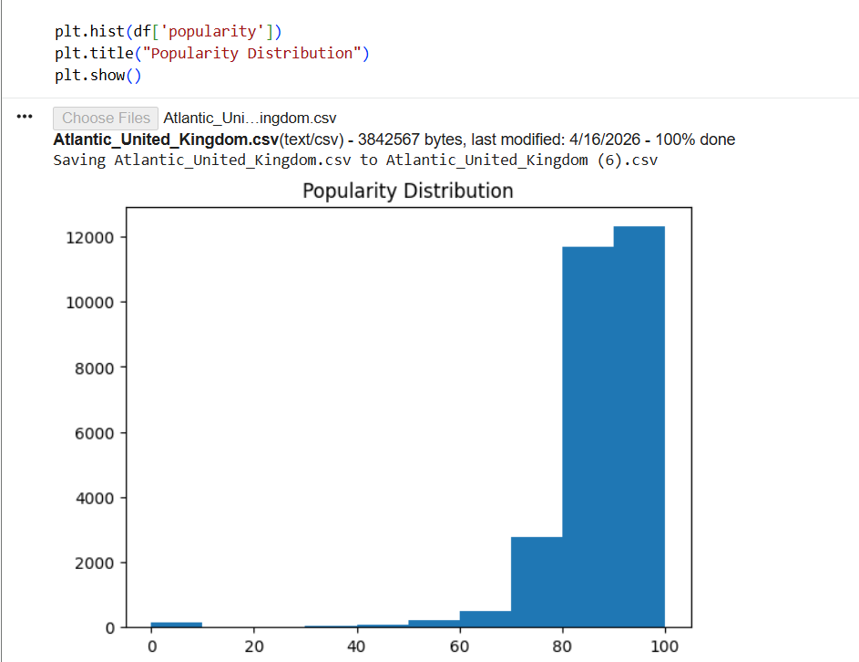
Popularity Graph
The dataset is biased towards high popularity because it contains chart songs only.

Slide 7
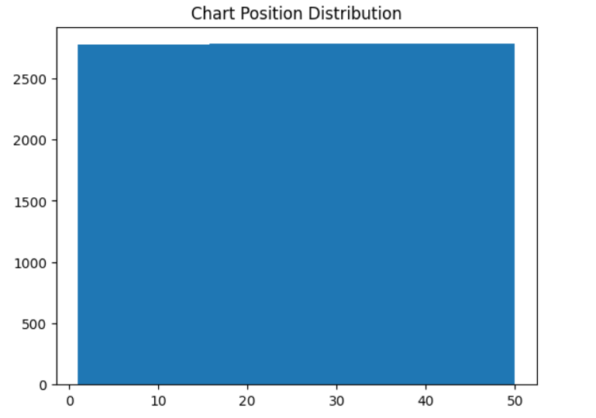
Position Graph
The distribution appears uniform because data includes multiple time periods.

Slide 8
Artist Analysis
Taylor Swift dominates charts
Global artists dominate UK market
Repeated artists observed

Slide 9
Model Used
Random Forest Classifier
Features: popularity, duration, total tracks

Slide 10
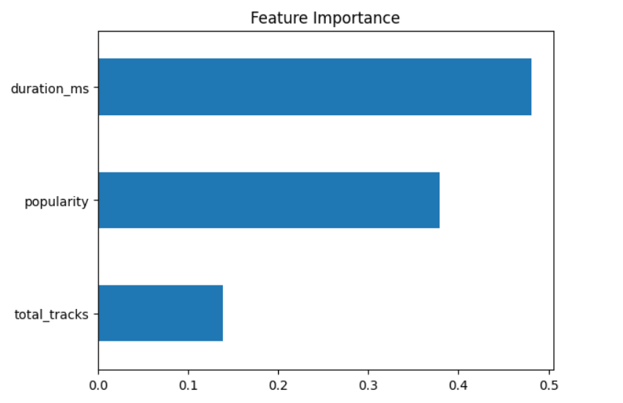
Feature Importance Graph
Duration (duration_ms) is the most influential feature in predicting hit songs.
Popularity also plays a significant role in song success.
Total tracks has relatively low impact on chart performance.
Song success depends on multiple factors, not just popularity.

Slide 11
Model Result
Accuracy: ~90%
Model predicts hit songs effectively

Slide 12
Feature Importance
Popularity most important
Duration less important
Multiple factors affect success

Slide 13
Key Insights
Popularity impacts ranking
International artists dominate
Patterns exist in hit songs

Slide 14
Conclusion
ML can predict song success
Useful for music analytics
Helps industry insights

Slide 15
Future Work
Add more features
Build recommendation system
Use real-time data

